Slide 1
C.LABEL-VR
VR-System for ImmersiveAnnotation of
3D Point Clouds

Slide 2
Schedule
Introduction
Motivation
Project goal
Introduction to Virtual Reality
System Components
The VR-Headset
The VR-Computer
The VR-Development Platform
The C.LABEL-VR Application
Import & Export
Navigation
Annotation
User Interface
Use Case
Conclusion
Challenges
Future Work

Slide 3
1. Introduction

Slide 4

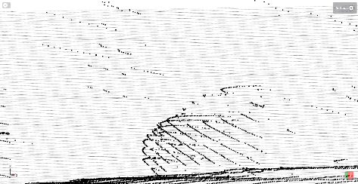
1. Introduction
a. Motivation
Improvement of label process
Intuitive control
User moves himself
Better Visualization
Point clouds in right scale
Touchable sensor data
Stand out from the competition
VR in industry is rare
Eye catching at exhibitions
VR is fun for most people
Very impressive for non technical people

Slide 5
1. Introduction
b. Project goal
Put together a system for developing and running of VR applications
Implement an application with following features:
Import and Export of at least one common point cloud data format
Visualization of the point cloud data
At least one possibility to move through a point cloud
At least one possibility to label points in a point cloud
Extend the application by new:
Labeling techniques
Navigation modes
Data formats

Slide 6
1.Introduction
c. Introduction to Virtual Reality
Beginning
The first ideas for a virtual environment came from I. E. Sutherland in 1965 ^{[1]}:
Display should serve as many senses as possible
Controls with force feedback joystick
Computer should sense human body muscles (hands, arms, eyes)
Manipulate the physics in the virtual world
Concepts which never before had any visual representation can be shown

Slide 7
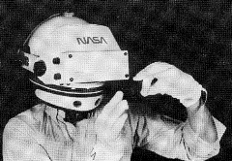
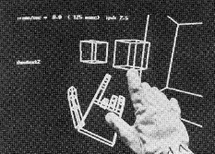
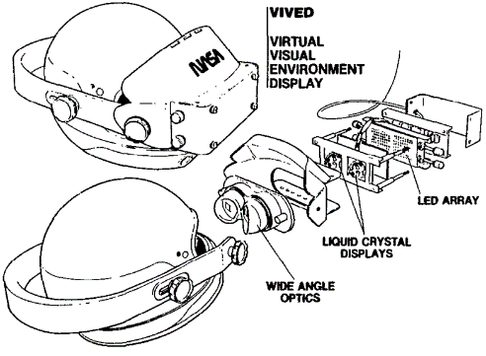
1.Introduction
c. Introduction to Virtual Reality
First Developments
VIVED System developed by the NASA ^{[2]}:
Head mounted device with integrated display (2,7”)
Integrated wide angle optics
Illusion of depth by stereoscopy
Input through voice recognition and gloves with motion sensors

Slide 8
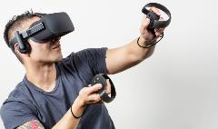
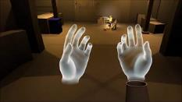
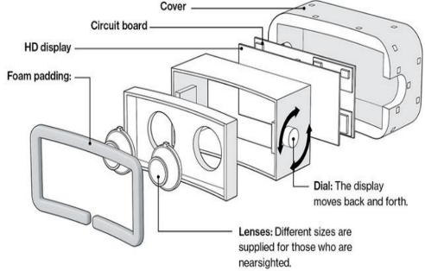
1.Introduction
c. Introduction to Virtual Reality
Today
VR as entertainment system, affordable by anyone:
Concept of VR system hasn’t changed
Better Display (2160 x 1200)
Additional tracking sensors
Faster computation by external PC
[3]
[4]
[5]

Slide 9
2. System Components

Slide 10
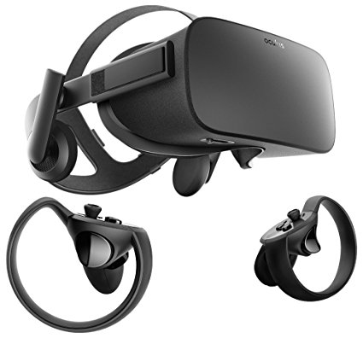
2.System Components
a. The VR-Headset
Oculus Rift
by Oculus VR, LLC.
2013: First developer version
2014: Facebook purchased Oculus for $2 billion
2016 : Official release of Oculus Rift
[6]

Slide 11
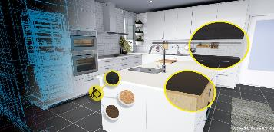
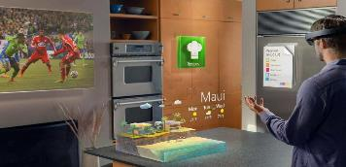

2.System Components
The VR-Headset
Why VR?
Virtual Reality
Limited space in virtual world
Almost unlimited movement possibilities
More control opportunities by VR-Controllers
Cheap acquisition costs
VR-Sickness
Augmented Reality
Very futuristic technology -> Eye catching
Intuitive Controls by gesture commands
Visualization space limited by physical space
Good visualization depends on environment lights
Controls limited by amount of gestures
Navigation limited by human movements
Quite expensive
[7]
[8]

Slide 12
2. System Components
b. The VR-Computer
Most important requirements
Frames must be rendered twice
High computation power needed
High end components produce heat
Good cooling needed
Oculus Rift and Sensors need one USB 3.0 each
Mainboard with enough ports
System Specifications
Component Type | Component Name
CPU | Intel® Core™ i7-7700K
GPU | Gainward GeForce GTX 1070 Phoenix
Mainboard | ASUS PRIME Z270-A
RAM | HyperX DIMM 16 GB DDR4-2400 Kit
SSD | Samsung 850 Pro 2,5” 512 GB
Power adapter | Cooler Master G550M 550W
CPU Cooler | Noctua NH-D9L
Case Cooler | 2x Coolink SWiF2-1200 120x120x25
Case | Cooler Master N300

Slide 13
2. System Components
c. The VR-Development Platform

Slide 16
Bibliography
[1] I. E. Sutherland, “The ultimate display,” in Proceedings of the IFIP Congress, 1965, pp. 506–508.
[2] S. S. Fisher, M. McGreevy, J. Humphries, and W. Robinett, “Virtual environment display system,” in Proceedings of the 1986 workshop on Interactive 3D graphics - SI3D '86. ACM Press, 1987.
[3] MSPoweruser, “All oculus rift users left in the dark following “cant reach oculus runtime services” error: Update – patch now available,” Internetquelle (abgerufen am 07.05.2018), May 2018. [Online]. Available: https://mspoweruser.com/all-oculus-rift-users-left-in-the-dark-following-cant-reach-oculus-runtime-services-error/
[4] TheMorenar, “Oculus rift cv1 - vrtk avatar sdk gamedev 3,” Internetquelle (abgerufen am 07.05.2018), May 2018. [Online]. Available: https://www.youtube.com/watch?v=Czc4V-Mxb5k
[5] P. R. Desai, P. N. Desai, K. D. Ajmera, and K. Mehta, “A review paper on oculus rift-virtual reality headset,” CoRR, vol. abs/1408.1173, 2014.
[6] Amazon, “Oculus rift + touch bundle,” Internetquelle (abgerufen am 07.05.2018), May 2018. [Online]. Available: https://www.amazon.de/OCULUS-Germany-301-00095-01-Oculus-Bundle/dp/B073X8N1YW
[7] S. W. Greg Vellante, “Ikea joins forces with htc vive for virtual reality kitchen,” Internetquelle (abgerufen am 07.05.2018), Apr. 2016. [Online]. Available: http://techomebuilder.com/emagazine-articles-1/ikea-joins-forces-with-htc-vive-for-virtual-reality-kitchen
[8] M. Holo, “Unterschied virtual reality (vr) und augmented reality (ar),” Internetquelle (abgerufen am 07.05.2018), May 2018. [Online]. Available: https://magic-holo.com/unterschied-virtual-reality-vr-und-augmented-reality-ar/

